Slide 1
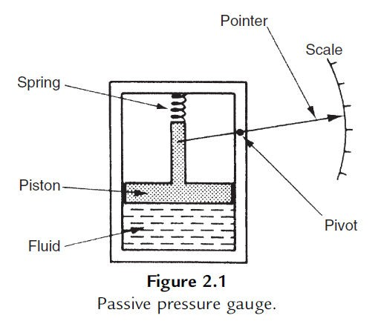
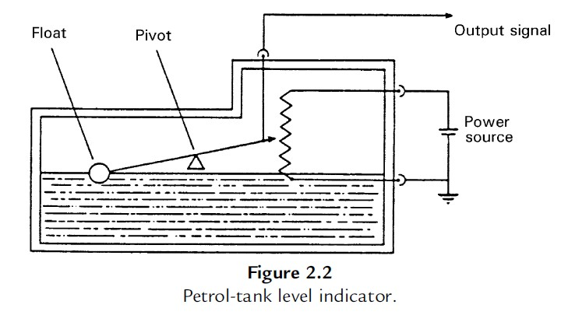
Instrumentation and Measurement
Fall-1393
Instrument Types
-Active and Passive Instruments
Passive: instrument output is produced entirely by the quantity being measured
Active: the quantity being measured simply modulates the magnitude of some external power source
-Null-Type and Deflection-Type Instruments
Deflection type: the value of the quantity being measured is displayed in terms of the amount of movement of a pointer (like the pressure gauge)
An alternative type of pressure gauge is the dead-weight gauge shown in Figure, which is a null-type instrument. Here, weights are put on top of the piston until the downward force balances the fluid

Slide 2
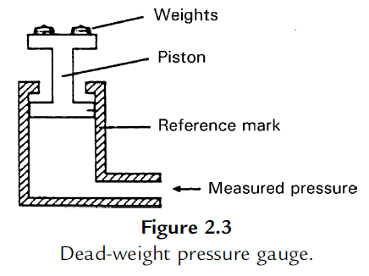
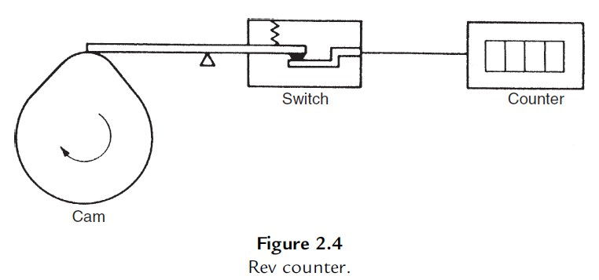
Instrumentation and Measurement
Fall-1393
pressure. Weights are added until the piston reaches a datum level, known as the null point. Pressure measurement is made in terms of the value of the weights needed to reach this null position. A general rule that null-type instruments are more accurate than deflection types
-Analogue and Digital Instruments
Analogue: gives an output that varies continuously as the quantity being measured changes. The output can have an infinite number of values within the range that the instrument is designed to measure (the deflection-type of pressure gauge)
Digital: has an output that varies in discrete steps and so can only have a finite number of values
Analogue instruments must be interfaced to the microcomputer by an analogue-to- digital (A/D) converter, which converts the analogue output signal from the instrument into an equivalent digital quantity that can be read into the computer.
-Indicating Instruments and Instruments with a Signal Output
Indicating: merely give an audio or visual indication of the magnitude of the physical quantity measured (normally includes all null-type instruments and most passive ones. Indicators can also be further divided into those that have an analogue output and those that have a digital display. A common analogue indicator is the liquid-in-glass thermometer)
With a Signal Output: give an output in the form of a measurement signal whose magnitude is proportional to the measured quantity (commonly as part of automatic control systems)

Slide 3
Instrumentation and Measurement
Fall-1393
-Smart and Non-smart Instruments
The advent of the microprocessor has created a new division in instruments between those that do incorporate a microprocessor (smart) and those that don’t
Static Characteristics of Instruments
If we have a thermometer in a room and its reading shows a temperature of 20ºC, then it does not really matter whether the true temperature of the room is 19.5 or 20.5ºC. Such small variations around 20ºC are too small to affect whether we feel warm enough or not. Our bodies cannot discriminate between such close levels of temperature and therefore a thermometer with an inaccuracy of ±0.5ºC is perfectly adequate. If we had to measure the temperature of certain chemical processes, however, a variation of 0.5ºC might have a significant effect on the rate of reaction or even the products of a process. A measurement inaccuracy much less than ±0.5ºC is therefore clearly required.
Accuracy of measurement is thus one consideration in the choice of instrument for a particular application. Other parameters, such as sensitivity, linearity, and the reaction to ambient temperature changes, are further considerations. These attributes are collectively known as the static characteristics of instruments and are given in the data sheet for a particular instrument. It is important to note that values quoted for instrument characteristics in such a data sheet only apply when the instrument is used under specified standard calibration conditions.
  Accuracy and Inaccuracy (Measurement Uncertainty)
The accuracy of an instrument is a measure of how close the output reading of the instrument is to the correct value. In practice, it is more usual to quote the inaccuracy or measurement uncertainty value rather than the accuracy value for an instrument. Inaccuracy or measurement uncertainty is the extent to which a reading might be wrong and is often quoted as a percentage of the full-scale (f.s.) reading of an instrument.
The aforementioned example carries a very important message. Because the maximum measurement error in an instrument is usually related to the full-scale reading of the instrument, measuring quantities that are substantially less than the full-scale reading means that the possible measurement error is amplified.
Example
A pressure gauge with a measurement range of 0–10 bar has a quoted inaccuracy of ±1.0% f.s. (±1% of full-scale reading). (a) What is the maximum measurement error expected for this instrument? (b) What is the likely measurement error expressed as a percentage of the output reading if this pressure gauge is measuring a pressure of 1 bar?

Slide 4
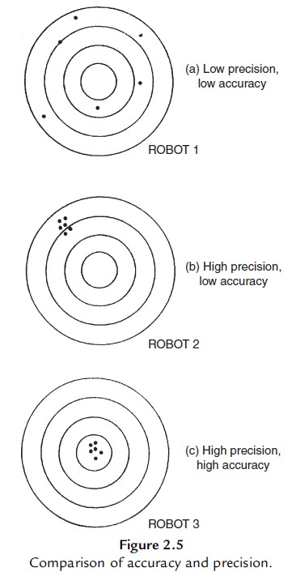
Instrumentation and Measurement
Fall-1393
2. Precision/Repeatability/Reproducibility
Precision is a term that describes an instrument’s degree of freedom from random errors. If a large number of readings are taken of the same quantity by a high- precision instrument, then the spread of readings will be very small. Precision is often, although incorrectly, confused with accuracy. High precision does not imply anything about measurement accuracy. A high-precision instrument may have a low accuracy. Low accuracy measurements from a high-precision instrument are normally caused by a bias in the measurements, which is removable by recalibration.
Tolerance
Tolerance is a term that is closely related to accuracy and defines the maximum error that is to be expected in some value. While it is not, strictly speaking, a static characteristic of measuring instruments, it is mentioned here because the accuracy of some instruments is sometimes quoted as a tolerance value. When used correctly, tolerance describes the maximum deviation of a manufactured component from some specified value.
Range or Span
The range or span of an instrument defines the minimum and maximum values of a quantity that the instrument is designed to measure.

Slide 5
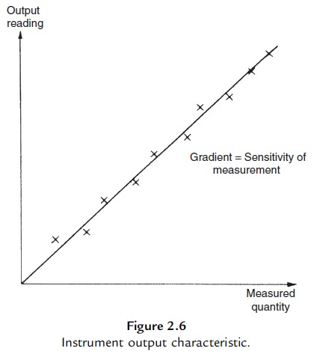

Instrumentation and Measurement
Fall-1393
5. Linearity
It is normally desirable that the output reading of an instrument is linearly proportional to the quantity being measured. The Xs marked on Figure 2.6 show a plot of typical output readings of an instrument when a sequence of input quantities are applied to it. Normal procedure is to draw a good fit straight line through the Xs, as shown in Figure 2.6.
Nonlinearity is then defined as the maximum deviation of any of the output readings marked X from this straight line.
6. Sensitivity of Measurement
The sensitivity of measurement is a measure of the change in instrument output that occurs when the quantity being measured changes by a given amount. Thus, sensitivity is the ratio:
The sensitivity of measurement is therefore the slope of the straight line drawn on Figure 2.6.
Threshold
If the input to an instrument is increased gradually from zero, the input will have to reach a certain minimum level before the change in the instrument output reading is of a large enough magnitude to be detectable. This minimum level of input is known as the threshold of the instrument. Manufacturers vary in the way that they specify threshold for instruments. Some quote absolute values, whereas others quote threshold as a percentage of full-scale readings.
Resolution
When an instrument is showing a particular output reading, there is a lower limit on the magnitude of the change in the input measured quantity that produces an observable change in the instrument

Slide 6
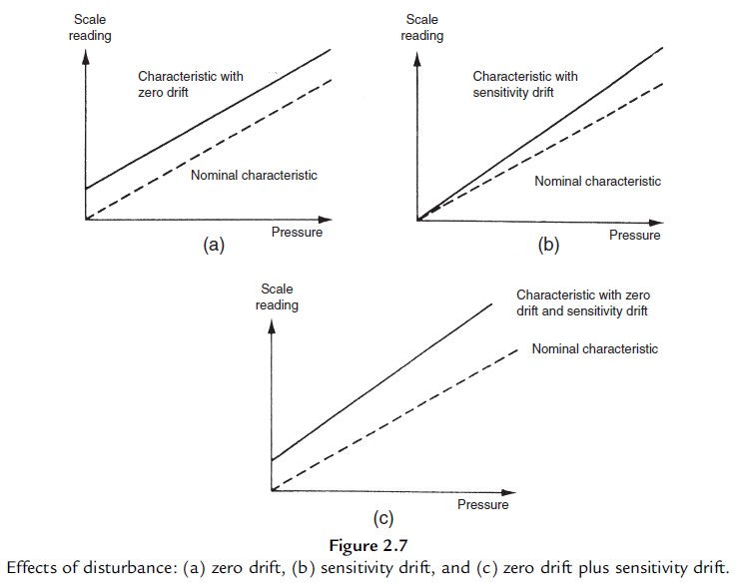
Instrumentation and Measurement
Fall-1393
output. Like threshold, resolution is sometimes specified as an absolute value and sometimes as a percentage of f.s. deflection. One of the major factors influencing the resolution of an instrument is how finely its output scale is divided into subdivisions.
9. Sensitivity to Disturbance
All calibrations and specifications of an instrument are only valid under controlled conditions of temperature, pressure, and so on. These standard ambient conditions are usually defined in the instrument specification. As variations occur in the ambient temperature, certain static instrument characteristics change, and the sensitivity to disturbance is a measure of the magnitude of this change. Figure 2.7
Example
The following table shows output measurements of a voltmeter under two sets of conditions: (a) Use in an environment kept at 20ºC which is the temperature that it was calibrated at. (b) Use in an environment at a temperature of 50ºC.

Slide 7
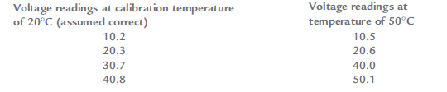
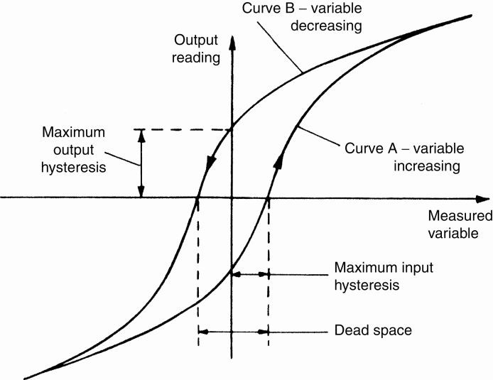
Instrumentation and Measurement
Fall-1393
Determine the zero drift when it is used in the 50ºC environment, assuming that the measurement values when it was used in the 20ºC environment are correct. Also calculate the zero drift coefficient.
Hysteresis Effects
If the input measured quantity to the instrument is increased steadily from a negative value, the output reading varies in the manner shown in curve A. If the input variable is then decreased steadily, the output varies in the manner shown in curve B. The non-coincidence between these loading and unloading curves is known as hysteresis.
Hysteresis is found most commonly in instruments that contain springs, when friction forces in a system have different magnitudes depending on the direction of movement, or in instruments that contain electrical windings formed round an iron core, due to magnetic hysteresis in the iron.
Dead Space
Dead space is defined as the range of different input values over which there is no change in output value. Any instrument that exhibits hysteresis also displays dead space. Some instruments that do not suffer from any significant hysteresis can still exhibit a dead space in their output characteristics, however. Backlash in gears is a typical cause of dead space and results in the sort of instrument output characteristic shown in Figure below. Backlash is commonly experienced in gear sets used to convert between translational and rotational motion.

Slide 8
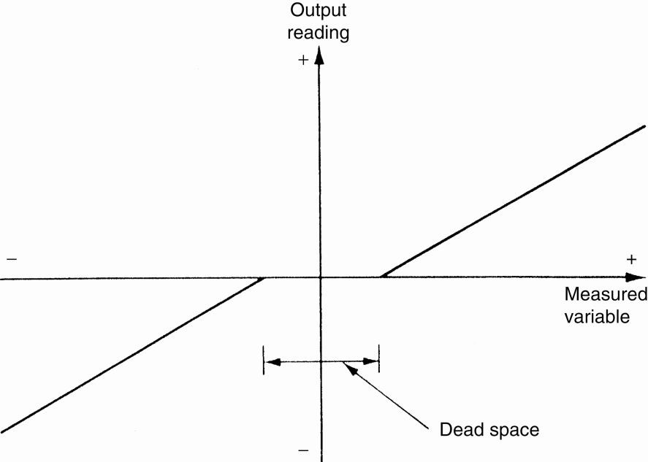

Instrumentation and Measurement
Fall-1393
B) Dynamic Characteristics of Instruments
The static characteristics of measuring instruments are concerned only with the steady-state reading that the instrument settles down to, such as accuracy of the reading. The dynamic characteristics of a measuring instrument describe its behavior between the time a measured quantity changes value and the time when the instrument output attains a steady value in response.
In any linear, time-invariant measuring system, the following general relation can be written between input and output for time (t) > 0:
(2.1)
Where qi is the measured quantity, qo is the output reading, and ao . . . an , bo . . . bm are constants.
If we limit consideration to that of step changes in the measured quantity only, then Equation (2.1) reduces to:
(2.2)
Further simplification can be made by taking certain special cases of Equation (2.2), which collectively apply to nearly all measurement systems.

Slide 9
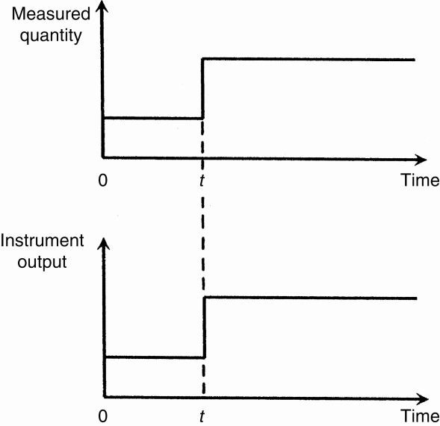

Instrumentation and Measurement
Fall-1393
1. Zero-Order Instrument
If all the coefficients a1 . . . an other than a0 in Equation (2.2) are assumed zero, then:
where K is a constant known as the instrument sensitivity as defined earlier.
Any instrument that behaves according to Equation (2.3) is said to be of a zero-order type.
Following a step change in the measured quantity at time t, the instrument output moves immediately to a new value at the same time instant t, as shown in Figure below. A potentiometer, which measures motion, is a good example of such an instrument, where the output voltage changes instantaneously as the slider is displaced along the potentiometer track.
2. First-Order Instrument
If all the coefficients a2 . . . an except for ao and a1 are assumed zero in Equation (2.2) then
Any instrument that behaves according to Equation (2.4) is known as a first-order instrument. If d/dt is replaced by the D operator in Equation (2.4), we get:

Slide 10

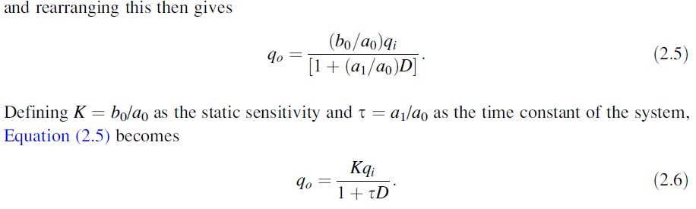
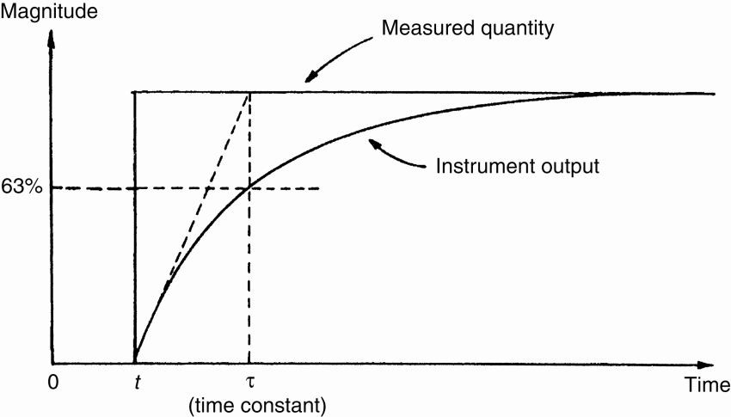
Instrumentation and Measurement
Fall-1393
If Equation (2.6) is solved analytically, the output quantity q0 in response to a step change in qi at time t varies with time in the manner shown in Figure below. The time constant τ of the step response is time taken for the output quantity q0 to reach 63% of its final value. The thermocouple is a good example of a first-order instrument.
A large number of other instruments also belong to this first-order class: this is of particular importance in control systems where it is necessary to take account of the time lag that occurs between a measured quantity changing in value and the measuring instrument indicating the change. Fortunately, because the time constant of many first-order instruments is small relative to the dynamics of the process being measured, no serious problems are created.
Example
A balloon is equipped with temperature and altitude measuring instruments and has radio equipment that can transmit the output readings of these instruments back to ground. The balloon is initially anchored to the ground with the instrument output readings in steady state. The altitude-measuring instrument is approximately zero order and the temperature transducer first order with a time constant
10

Slide 11
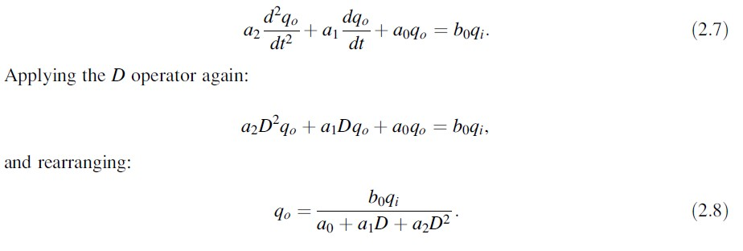
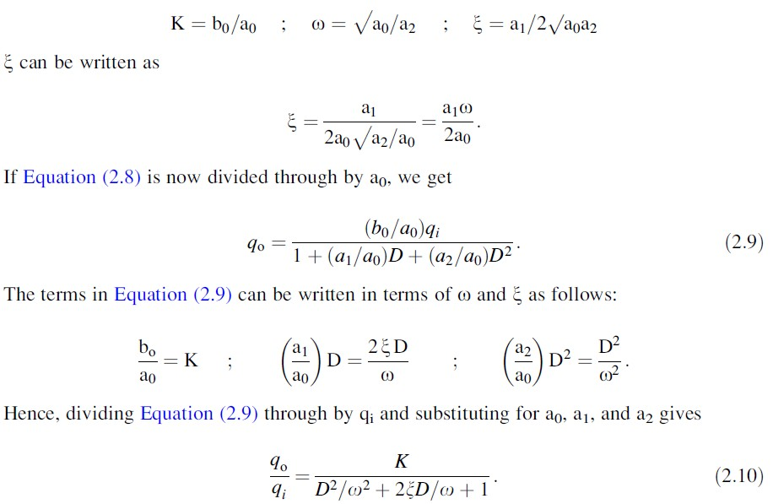
Instrumentation and Measurement
Fall-1393
of 15 seconds. The temperature on the ground, T0, is 10°C and the temperature Tx at an altitude of x
metres is given by the relation: Tx D T0 - 0.01x
If the balloon is released at time zero, and thereafter rises upwards at a velocity of 5 metres/second, draw a table showing the temperature and altitude measurements reported at intervals of 10 seconds over the first 50 seconds of travel. Show also in the table the error in each temperature reading.
What temperature does the balloon report at an altitude of 5000 metres?
3. Second-Order Instrument
If all coefficients a3 . . . an other than a0, a1, and a2 in Equation (2.2) are assumed zero, then we get:
It is convenient to re-express the variables a0, a1, a2, and b0 in Equation (2.8) in terms of three parameters: K (static sensitivity), ω (undamped natural frequency), and ξ (damping ratio), where:

Slide 12
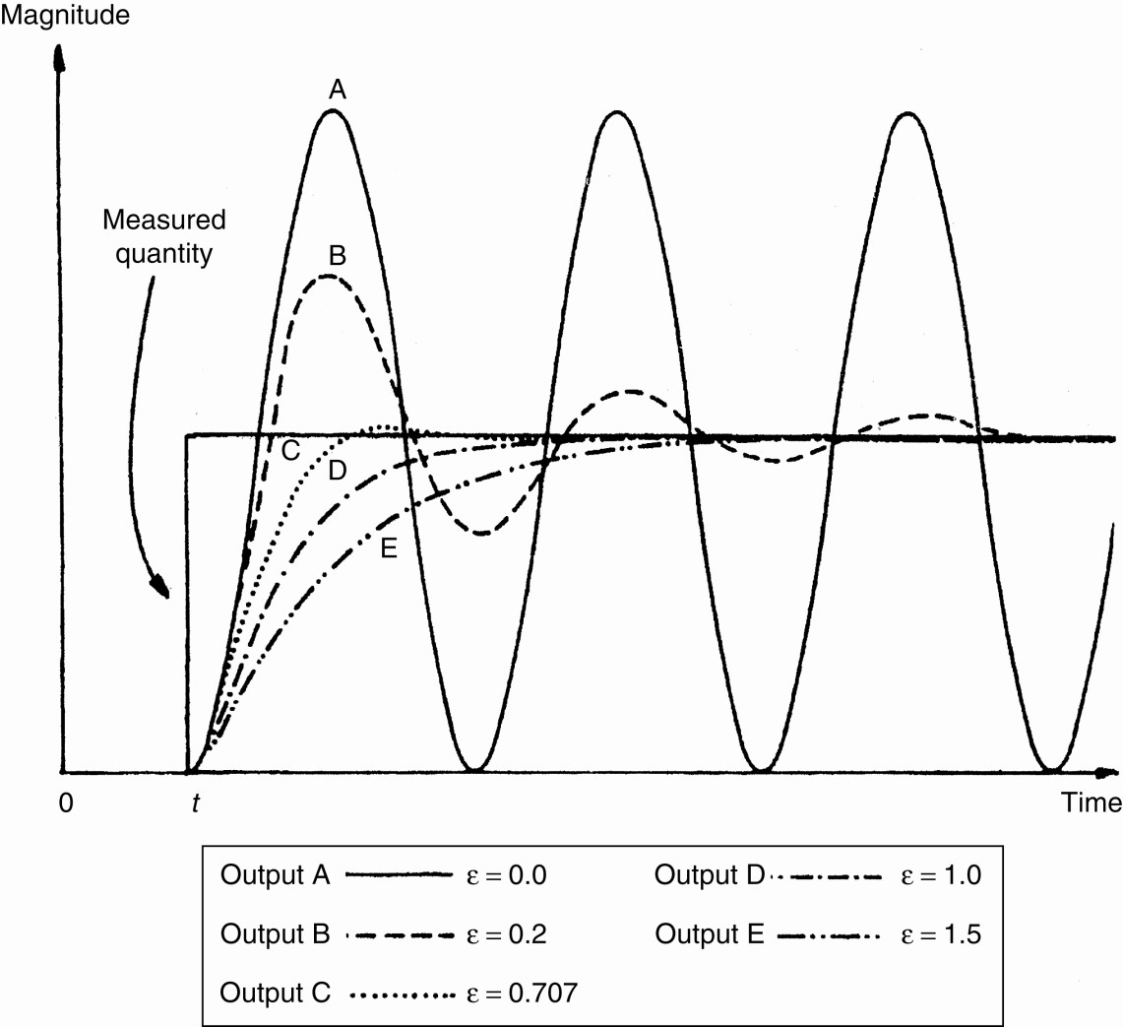
Instrumentation and Measurement
Fall-1393
This is the standard equation for a second-order system, and any instrument whose response can be described by it is known as a second-order instrument. If Equation (2.9) is solved analytically, the shape of the step response obtained depends on the value of the damping ratio parameter x. The output responses of a second-order instrument for various values of x following a step change in the value of the measured quantity at time t are shown in Figure below.
References:
-Measurement and instrumentation: theory and application / Alan S. Morris; Reza Langari, 2012

